Slide 1
Programming For Problem Solving
Unit - 1: Introduction to Programming
Introduction to components of a computer system: disks, primary and secondary memory, processor, operating system, compilers, creating, compiling and executing a program etc., Number systems
Introduction to Algorithms: steps to solve logical and numerical problems. Representation of Algorithm, Flowchart/Pseudo code with examples, Program design and structured programming
Introduction to C Programming Language: variables (with data types and space requirements), Syntax and Logical Errors in compilation, object and executable code , Operators, expressions and precedence, Expression evaluation, Storage classes (auto, extern, static and register), type conversion, The main method and command line arguments Bitwise operations: Bitwise AND, OR, XOR and NOT operators
Conditional Branching and Loops: Writing and evaluation of conditionals and consequent branching with if, if-else, switch-case, ternary operator, goto, Iteration with for, while, do- while loops
I/O: Simple input and output with scanf and printf, formatted I/O, Introduction to stdin, stdout and stderr. Command line arguments.

Slide 2
Programming For Problem Solving
Unit - II: Arrays, Strings, Structures and Pointers:
Arrays: one and two dimensional arrays, creating, accessing and manipulating elements of arrays
Strings: Introduction to strings, handling strings as array of characters, basic string functions available in C (strlen, strcat, strcpy, strstr etc.), arrays of strings Structures: Defining structures, initializing structures, unions, Array of structures.
Pointers: Idea of pointers, Defining pointers, Pointers to Arrays and Structures, Use of Pointers in self-referential structures, usage of self referential structures in linked list (no implementation)
Enumeration data types.

Slide 3
Programming For Problem Solving
Unit - III: Preprocessor and File handling in C:
Preprocessor: Commonly used Preprocessor commands like include, define, undef, if, ifdef, ifndef
Files: Text and Binary files, Creating and Reading and writing text and binary files, Appending data to existing files, Writing and reading structures using binary files, Random access using fseek, ftell and rewind functions.
Unit - IV: Function and Dynamic Memory Allocation:
Functions: Designing structured programs, Declaring a function, Signature of a function, Parameters and return type of a function, passing parameters to functions, call by value, Passing arrays to functions, passing pointers to functions, idea of call by reference, Some C standard functions and libraries
Recursion: Simple programs, such as Finding Factorial, Fibonacci series etc., Limitations of Recursive functions
Dynamic memory allocation: Allocating and freeing memory, Allocating memory for arrays of different data types

Slide 4
Programming For Problem Solving
Unit - V: Introduction to Algorithms:
Algorithms for finding roots of a quadratic equations, finding minimum and maximum numbers of a given set, finding if a number is prime number, etc.
Basic searching in an array of elements (linear and binary search techniques),
Basic algorithms to sort array of elements (Bubble, Insertion and Selection sort algorithms), Basic concept of order of complexity through the example programs
TEXT BOOKS:
1. Byron Gottfried, Schaum’s Outline of Programming with C, McGraw-Hill
2. B.A. Forouzan and R.F. Gilberg C Programming and Data Structures, Cengage Learning, (3rd Edition)
REFERENCE BOOKS:
1. Brian W. Kernighan and Dennis M. Ritchie, The C Programming Language, Prentice
2. Hall of India
3. R.G. Dromey, How to solve it by Computer, Pearson (16th Impression)
4. Programming in C, Stephen G. Kochan, Fourth Edition, Pearson Education.
5. Herbert Schildt, C: The Complete Reference, Mc Graw Hill, 4th Edition

Slide 5
INTRODUCTION TO COMPUTERS
COMPUTER is a fast calculating electronic device that takes input (Data) and produces output (Information).
COMPUTER can be abbreviated as “Commonly Operated Machine Particularly Used in Trade, Education & Research”.
COMPUTER is an Electronic machine that follows a set of instructions written by the User and also accept input data and transform these into information.

Slide 6
INTRODUCTION TO COMPUTERS
Input: Collection of items (or) objects like alphabets, numbers, special characters etc. It is also called Data. It is in Raw form.
Output: The result of the processing input is called an Output. It is also called Information (or) Result.
A computer is basically a System made up of two major components:
1) Hardware 2) Software 3) Firmware

Slide 7
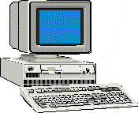
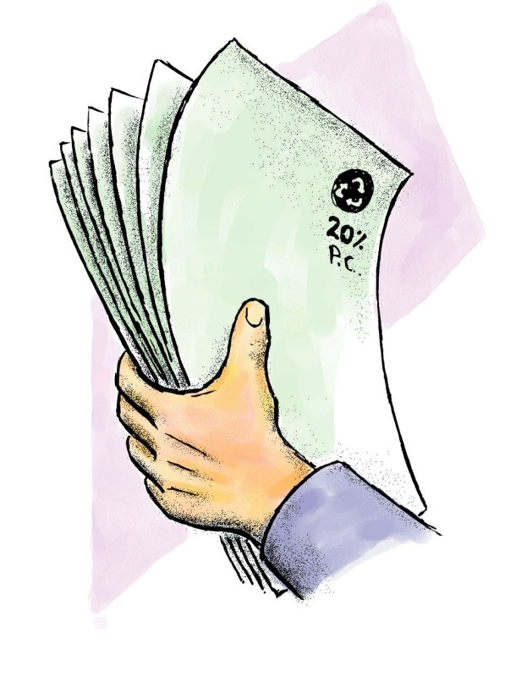
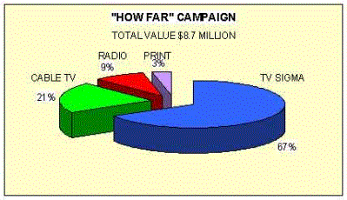
PROCESSING SYSTEM
DATA
INFORMATION

Slide 8
Computer Hardware
Hardware is nothing but Physical components of the computer system.
The computer system consists of Three major components:
  Central Processing Unit (CPU),
  Memory Components- (Primary storage, Auxiliary storage devices),
  Input devices and Output devices.
The Central Processing Unit (CPU) is responsible for executing instructions such as arithmetic calculations, comparisons among data, and movement of data inside the system. Today’s computers may have one, two or more CPUs.

Slide 9
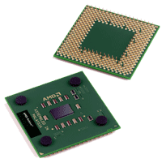
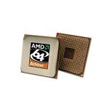
CPU is referred as brain of the computer.
It is a small Integrated Chip(IC) plugged on the Motherboard.
Mother board: It is a large circuit board that connects all other IC’s along with CPU (or) Processor Chip.

Slide 10
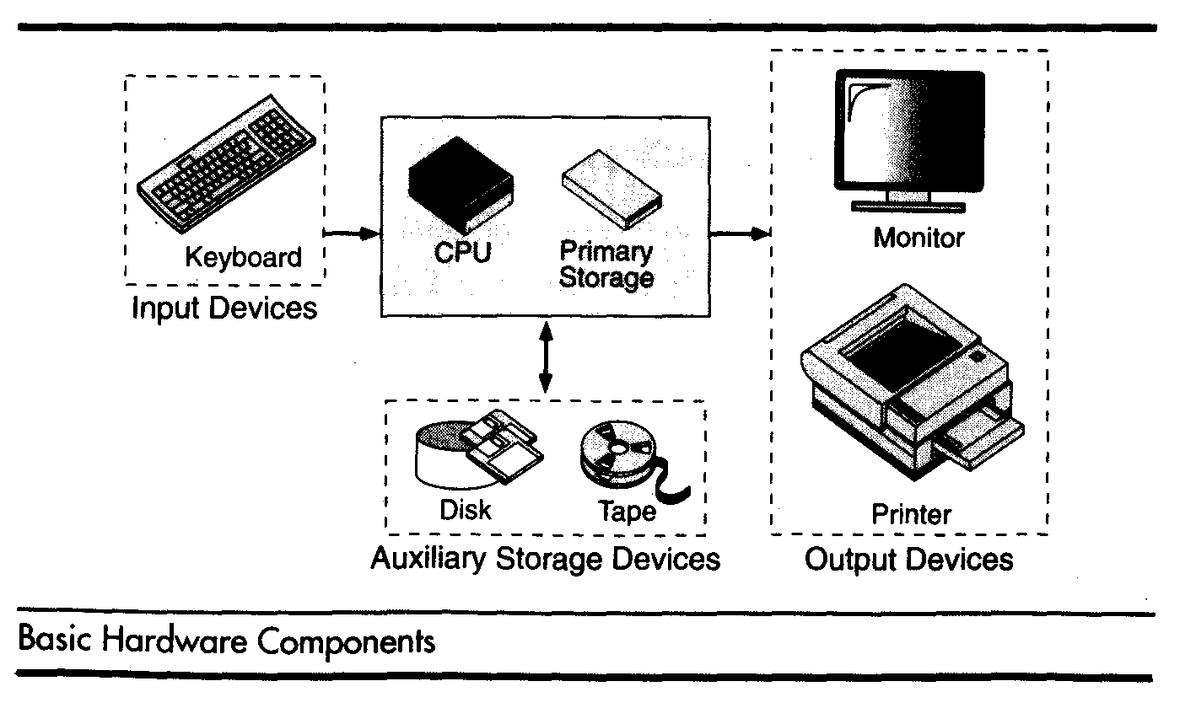

Slide 11
The Main function of the CPU is executing the programs.
CPU executes the programs by performing the following operations.
a) Fetch instructions – The CPU reads instructions from memory.
b) Interpret instructions – The fetched instructions are decoded/ Interpreted.
c) Fetch data – The CPU fetches input either from memory (or) input devices.
d) Process data – The fetched input data is to be processed.
e) Write result – The result is displayed on output devices.

Slide 12
Arithmetic and Logical Unit (ALU)
ALU performs Arithmetic and Logical operations like Addition, Subtraction, Multiplication, Division, Comparison and Logical operations like AND, OR, NOT etc.
The complete Execution part in CPU is carried out by ALU.

Slide 13
Control unit (CU)
It Controls all the components of the Computer.
The main function of the control unit is, it generates control and timing signals for executing the Instructions (or) Programs.
The control unit performs two basic operations.
a) Fetch operations. b) Execute operations.
The time required to carrying out the Fetch operation and Execute operation is known as Fetch cycle (F.C) and Execute cycle (E.C). The combination of these two cycles is nothing but Instruction cycle (I.C).

Slide 14
Control unit (CU)
It generates the following Control signals.
a) Memory Read (MR): It reads the data from memory
b) Memory Write (MW): It writes the data on Memory.
c) I/O Read (I/O R): It reads the input from Input devices.
d) I/O Write (I/O W): It displays data on output devices.

Slide 15
Registers
Registers are temporary storage locations within the CPU.
Registers are classified in to two types.
1) General Purpose Registers:
  a) Accumulator (Acc or Register A).
  b) Temporary Register (TR).
  c) Multiplier Quotient (MQ).
2) Special Purpose registers.
a) Program Counter (PC).
b) Memory Address Register (MAR).
c) Memory Buffer Register (MBR).
d) Instruction Register (IR).

Slide 16
Memory Components
It is a kind of Storage device.
Memory is used to store the data.
Generally, Memories are slow devices when compared to CPU.
Memory is classified in to two types.
a) Primary Memory
b) Auxiliary Memory.

Slide 17
Primary Memory
Also called Semi Conductor Memory (or) Main Memory.
It is a place where the programs and data are stored temporarily during processing.
Main Memory makes the CPU access fast.
The size of main memory ranges from 8 MB to 5 Giga Bytes.
It is directly accessible to CPU because it is plugged on the mother board itself.

Slide 18
Main Memory is again classified in to two types.
1) ROM (Read Only Memory) is a Non-Volatile Memory. The content (or) data is safe when computer is turned off. Some set of instructions like BIOS setup, DOS key installed, size of hard disk and other system settings are stored in the ROM.
2) RAM (Random Access Memory) is a Volatile Memory. The content (or) data will be lost when the computer is suddenly turned off (or) power off, until that time it is safe. It is writable and readable.

Slide 19
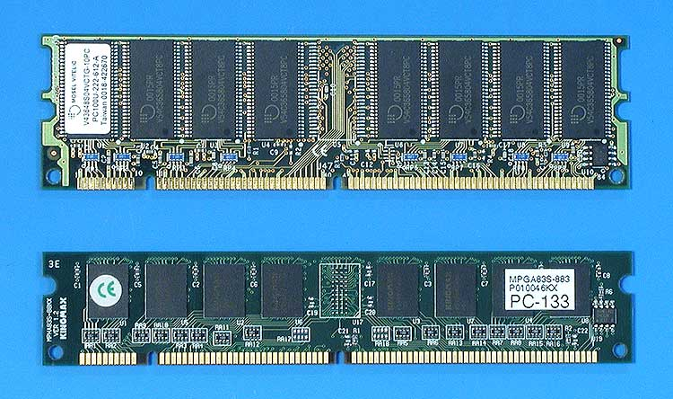
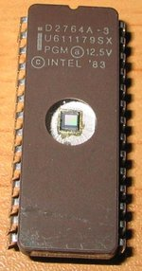
RAM
ROM

Slide 20
Auxiliary Memory
Also called Secondary Memory (or) Magnetic Memory.
It is the place where the programs and data are stored permanently.
When we turn off the computer, the programs and data remain in the secondary storage and they are ready for the next time when we need them.
The storage size of secondary memory is available in Terabytes.
Secondary Memory devices are much cheaper and slower than main memory devices because it is not directly plugged on the mother board and it is connected to CPU with a group of wires called BUS.

Slide 21
There are two primary technologies used in the secondary memories.
They are (1) Magnetic (2) Optical.
Magnetic Tapes
  Used to store large amount of data.
  It provides Serial access only.
  The Width of the tape is 0.5 inches and the Length of the tape is varies from 1200 to 3600 feet.
  The contents of the magnetic tape can be erased and recorded many number of times.
  By using Electro Magnetic pulses the information can be recorded on the tape.
  A Magnetic tape is divided in to Horizontal rows called Tracks & Vertical Columns called Frames.

Slide 22
Auxiliary Memory – Hard Disk
Magnetic Disks (or) Hard disks
  Hard Disks are used to store large amount of data.
  It provides direct access.
  We can write & erase the data number of times.
  Disk consists of no. of invisible circles called Tracks and these tracks are divided into sections called Sectors.
  The capacity of hard disks ranges up to Tera bytes of storage.

Slide 23
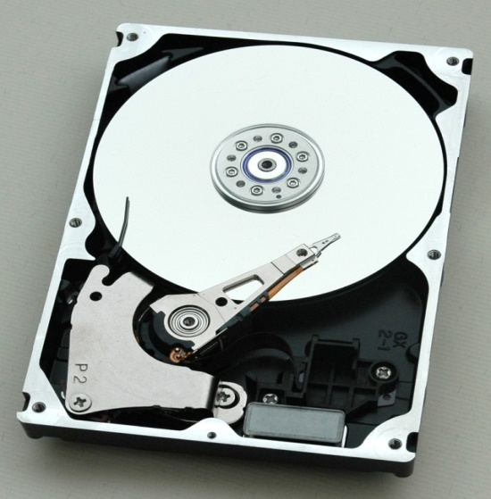
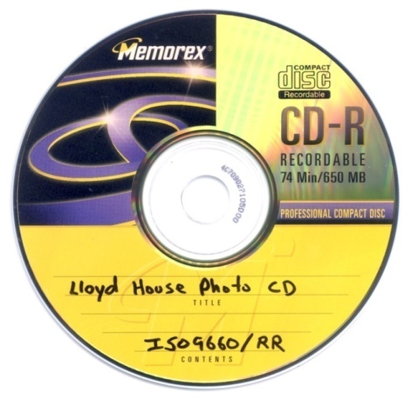
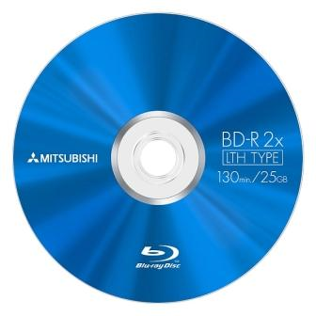
Compact Disk (Optical Technology)
Hard Disk Drive (HDD)
Blue Ray Disk – 40G
Digital Versatile Disk
  DVD-R – write once, 3.95G
  DVD RW – rewritable, 3G
  Single Layer and Double Layer
Compact Disk
  CD-R – write once, 650MB
  CD-RW – rewritable, 700MB
DVD (Optical Technology)

Slide 24
Input & Output devices
Input and Output devices provide Man-to-Machine and Machine-to-Man communication.
I/O devices are also called Peripheral devices. because they are connected outside to the computer i.e., peripherally.

Slide 25
Different Input devices
Key board
Mouse
Light pen (or) Stylus
Joystick
Touch screen
Scanner
Barcode reader
Micro phone (or) Mike
Web camera (or) Webcam.

Slide 26
Different Output devices
Monitor
Printer
Speakers
Head phones
Plotter
Projectors

Slide 27
Keyboard
It is the most common input device for computer. With the help of Keyboard only, we can enter the data and programs in to the computer. It is like a Typewriter.
A keyboard contains minimum of 106 keys. It has 4 different types of keys.
  Alphabetical keys: It includes all the alphabets (both upper and lower case).
  Numeric and special keys: It includes all the numbers (0 to 9) and some special keys like delete, insert, num lock, enter, back space, tab, esc, shift, alt, ctrl etc…
  Function keys: It includes F1, F2, F3, F4, ………F12. The function keys are used to perform the functions.
  Cursor movement keys: It includes arrow keys like left, right, up, down and home, end, page up, page down etc…

Slide 28
Mouse
It is a pointing device and also a Handy device. It can be operated by hand. Mouse can point any portion on the Screen.
Mouse pointer can be representing with I (or) arrow. Mouse is very useful in GUI (Graphical User Interface) applications.
Mouse has one roller on its base. That roller is called Track ball. By using Mouse we can draw figures in computer.
A mouse generally has two (or) three buttons.
  Left button is used for select an item as well as open a file.
  Right button is used for selecting choices/ Menus.
  Middle button is used to scroll the pages in a file.

Slide 29
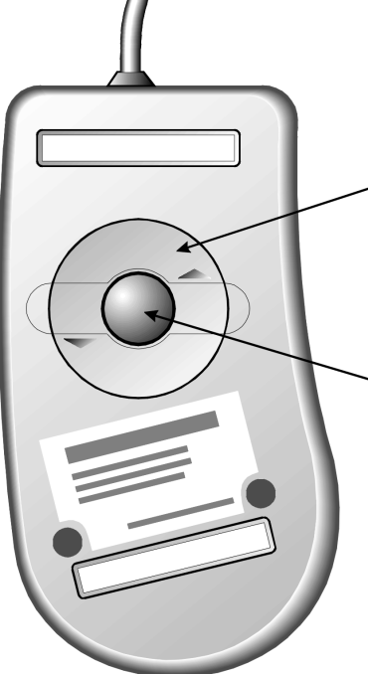

Two Types of Mouse
Mechanical - a type of computer mouse that has a rubber or metal ball on its underside and it can roll in every direction.
Optical: This type uses a laser for detecting the mouse's movement.

Slide 30
Light pen:
  It is also a pointing device and handy device.
  It consists of photoelectrical tube mounted on a pen shaped holder.
  When the light pen is brought in front of picture element of the screen, it senses the light and selects the portion on the screen.
  It was used by cricket Commentators.
Joystick:
  It is a Handy device.
  Joystick is normally used to play the video games.
  On the base it has one roller to move the stick from center position to left position (or) right position.

Slide 31
Barcode Reader:
  It is an Input device.
  Commonly used at central Libraries and Super markets.
  It is a Image Scanner. It reads the UPC’s (Universal Product Key).
  The Barcode reader first emits the light on barcode, then it reads the UPC of the product and it translate the key in to numbers and send it to computer for further process.
Touch screen:
  It is both I/P and O/P device.
  It is operated with the help of finger.
  We can make selection directly by touching the screen. i.e., when we select the input options it passes the information to computer and the output will also displayed on the screen.
  It is also called ‘KIOSK’.

Slide 32
Scanner:
  It is used to scan the images as well as data.
  It scans the pixels of the image and sends it to computer for further process.
  OCR (Optical Character Recognition) software is used to scan the images (or) data.
Microphone (or) Mike:
  Mike receives the voice signal (Analog signal) and sends it to speaker.
  To translate the analog signal in to digital signal we are using sound cards.
Web camera (or) Web cam:
  It takes the Pictures and sends it to the computer.
  Those pictures will be stored in the form of Digital.

Slide 33
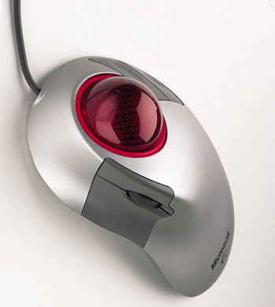
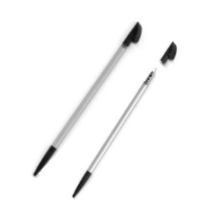
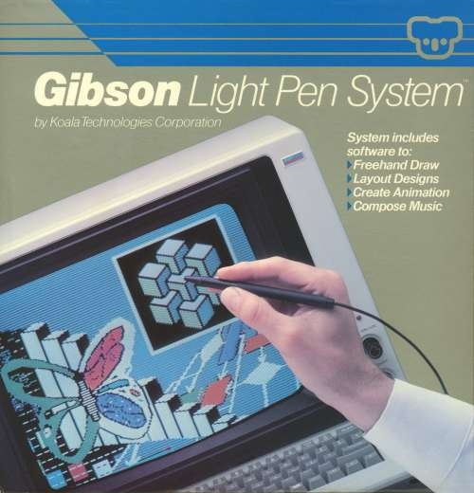
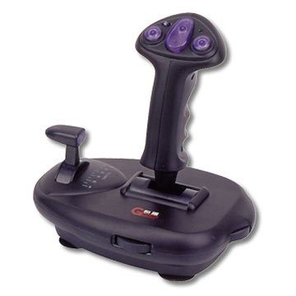
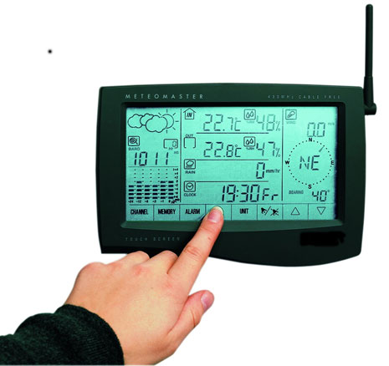

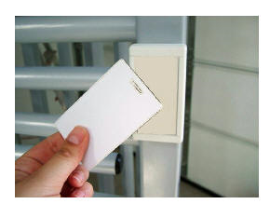
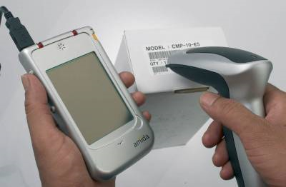

Slide 34
Monitor
Monitor is also called CRT (Cathode Ray Tube).
CRT’s are often called as Video Display Units (VDU) or Screens.
The main components of a CRT display unit are
  The Electron gun
  The Electron beam controlled by Electro-magnetic field.
  A Phosphor coated screen.
The Electron gun emits an electron beam which is directed to the phosphor coated display by applying electromagnetic field in order to create an image.

Slide 35
Monitor
The image on the screen can be displayed in two ways.
  Raster Scan Display: In Raster scan display, the electron beam starts from top left corner of the screen and moves along first horizontal line. The entire process is repeated until the screen gets a full image.
  Vector Display: In Vector display, the electron beam is directed at the places where the image is to be created.

Slide 36
Printers:
  Printers are used to produce output on Paper.
  Printers are most common output devices for computer.
  Printers are classified in to four types according to their print quality, print speed and cost. They are
  a) Dot Matrix Printer b) Line Printer
  c) Laser Printer d) Color jet Printer.
Plotters:
  These are used for Architectural and Engineering Drawings.
  It has Robotic arms and pens to produce large line drawings.
  These are capable to producing high-resolution graphics by the computers.
  These are more expensive than Printers.

Slide 37
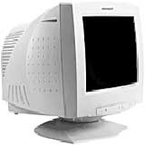
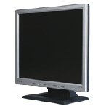
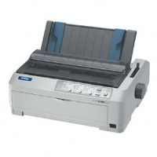
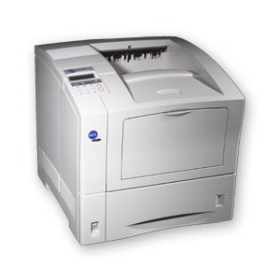
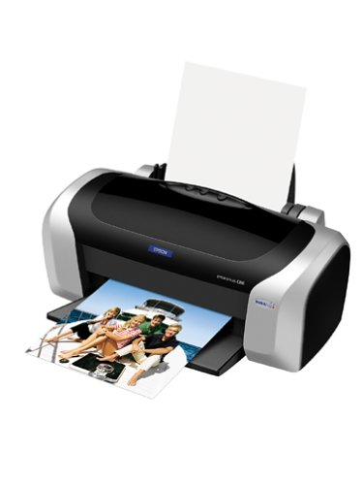
Cathode Ray Tube (CRT)
Liquid Crystal Display (LCD)
Dot matrix printer
Inkjet printer
Laser printer

Slide 38
Speakers & Head phones:
  These devices produce high quality sound and audio information.
  These devices are using Sound cards to convert digital signal in to audio (voice) signal.
Projectors:
  It is also an output device.
  These are used to project the image on a wall screen.
  There are different types of Projectors
    1) LCD (Liquid Crystal Display) Projectors.
    2) DLP (Digital Light Processing) Projectors.
    3) LED (Light Emission Display) Projectors.

Slide 39
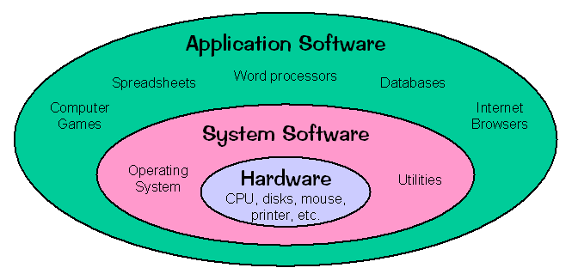
Computer Software
It is a set of instructions given to the computer to perform particular task.
Computer software is divided in to two Categories:
  System software.
  Application software.

Slide 40
System software
System software is a program loaded in to the computer while in the installation time.
System software manages all the Computer resources.
It provides the interface between the Hardware and the Users.
It is software that contains set of instructions (programs) written by the manufacturer/Vendor.
Those programs can manage the hardware resources of a computer.
The Examples of System Software's are
  Operating system (OS)
  System support and system development software's.

Slide 41
Operating system (OS)
The Operating System can shortly referred as ‘OS’.
Operating System provides User interface, File and database access, and also provide interfaces to communication systems such as Internet protocols.
The primary purpose of this software is to keep the system operating in an efficient manner when the users are accessing the system. i.e., it allows users to interact with computer through the Commands.

Slide 42
System support and Development software
Language translators that convert programs into machine language for execution.
Computer–Assisted Software Engineering (CASE) tools.
The different Language translators are:
  Assembler
  Compiler
  Interpreter
  Loader
  Linker

Slide 43
Assembler: Assembler translates Assembly level language program in to Machine level language programs (i.e., Assembly level Source code in to Object code).
Ex: 8085 Assembler, 8086 Assembler.
Compiler: Compiler translates High-level language program in to Machine level language programs (i.e., Source code in to Object code). It translates whole program at a time.
Ex: Pascal, COBOL, C, C++, JAVA Compilers etc.
Interpreter: Interpreter translates High-level language program in to Machine level language programs (i.e., Source code in to Object code). But it translates statement by statement.
If there is any error in any Statement it shows error Message, after rectification of the error only it will continue to next statement.

Slide 44
Loader: It is a software that loads the program in to main memory and makes it ready for Execution.
Linker: It is a software that links all the Pre processor Directive functions (Library Header files) to our final executable Program.
The library functions, such as standard input/output (stdio.h) functions, Mathematical library (math.h) functions and other Standard Library functions (stdlib.h) must be attached to our program.
Source code is a program, which is written in high-level language. (Ex: .C file).
Object code is a program, which is in machine understandable form (Low level). (Ex: .obj file)
Executable code is a program, which is successfully compiled & ready for execution. (Ex: .exe file)

Slide 45
Application software
It is a set of instructions written by the User to perform (or) execution of the task.
It is directly responsible for helping users to solve their tasks.
Application software is broken in to two categories:
  General-purpose software
  Application –specific software.

Slide 46
General purpose software:
  Purchased from a software developer and can be used for more than one application.
  Examples of General Purpose software include:
    Microsoft Office packages (like MS-Word, MS-Excel, MS-Power point, MS-Access)
    Data Base Management System (DBMS) packages (like ORACLE, DBA, D2K)
    CAD/CAM (Computer Aided Design/ Computer Aided Manufacturing) packages.
  Application–specific software:
    Used only for its intended/ Specific purpose. i.e., only for the task for which they were designed.
    They cannot be used for other generalized tasks.
    Example: A general ledger system (ex: Tally Software) used by accountants.

Slide 47
Computer Languages
Language is a communication between one person to another person.
Computer Language provides the communication between human-being and Computer.
Computer language contains a set of rules and symbols used to operate a computer. These are called the syntax rules of the language.
Whatever command we give to computer, it is first converted in its own language (Computer Understandable language).
Programming Language can be defined as a language which is used to express set of computer instructions in the form of programs to perform our task.

Slide 48
Machine level Languages
In Machine level Language, the instructions are written as combination of binary numbers (i.e., 0’s and 1’s).
It is also referred as Binary Language.
The computer uses only Machine Language while executing the program.
The instructions in machine language must be formed with 0’s & 1’s. Because the internal circuits of computer are made of transistors, switches, and other electronic devices that can be in one of two states: OFF /ON.
  The OFF state is represented by 0, ON state is represented by 1.
The only language understood by computer hardware is Machine language.

Slide 49
Machine level Languages
Machine language instruction format consists of Two parts.
a) OPCODE – Operation code (Specifies function of the instruction).
b) OPERAND – Input value address / location.
For ex: ‘0000 0001’ OPCODE may specify Addition operation is to be performed.
Advantages: 1) Computer understands only Machine language.
2) Programs can run at very fast.
Disadvantages: 1) Programmer has to remember all the OPCODES (Binary codes).
2) Machine language is Machine dependent.
3) Correction and modification of the program is very difficult.
4) Programs are very lengthy.

Slide 50
Assembly level Languages
In assembly level language, each operation code of the machine language is represented by a symbolic code called mnemonic and address of the operand represented by symbolic address.
Each instruction of assembly language contains Symbolic operation code and Symbolic address.
It is also called Symbolic Language.
  For ex:
‘ADD’ is mnemonic opcode for Addition.
‘SUB’ is mnemonic opcode for Subtraction.
‘LOAD’ is mnemonic opcode for load (or) assigns the Value.
‘STORE’ is mnemonic opcode for storing the value.

Slide 51
Assembly level Languages
Assembler is used to translate assembly language program in to machine language.
Assembly Language programs are easy to write and modify than Machine language programs.
The assembly level languages are also Machine dependent. i.e., assembly language code is different for different machines.
Advantages: 1) No need to remember all binary operation codes and addresses.
2) Program correction / Modifications are easy.
3) Language is simple compared to Machine Language.
Disadvantages: 1) Program execution takes more time because it needs to convert in to machine level.
2) Assembly language is Machine dependent.
3) It requires assembler to translate program in to Machine level.

Slide 52
High Level Languages
All spoken and written languages are high-level languages. The best examples of high- level languages are Programming languages.
In high-level languages, the instructions are written by using symbols and words.
High level Languages are Machine independent, because the program can run on all the different machines.
It is very easy to write, modify and maintain.
The high-level languages are Portable, because they can carry from one system to another system.
High level languages must also be converted into machine language.
Compiler is a program that translates high-level language program in to machine language.

Slide 53
High Level Languages
Advantages:
1) It is easy to use and understand than Low–level languages.
2) High level language provides better documentation than Low–level.
3) Program Modifications or Debugging are very easy.
4) High-level languages are Machine Independent.
5) Suitable for complex Applications.
Disadvantages:
1) It takes more execution time than Low– level.
2) It requires Compiler to translate program in to Machine level.

Slide 54
Creating and Running Programs
Computer understands a program, only if it is written (or) coded in its understandable machine language.
So, it is the job of the programmer or computer user to write and test the program.
There are four steps involved in this process:
  1. Writing and Editing the program (Source File)
  2. Compiling the program (Object File)
  3. Linking the program with the required library modules (Object File).
  4. Executing the program (.Exe File)

Slide 55
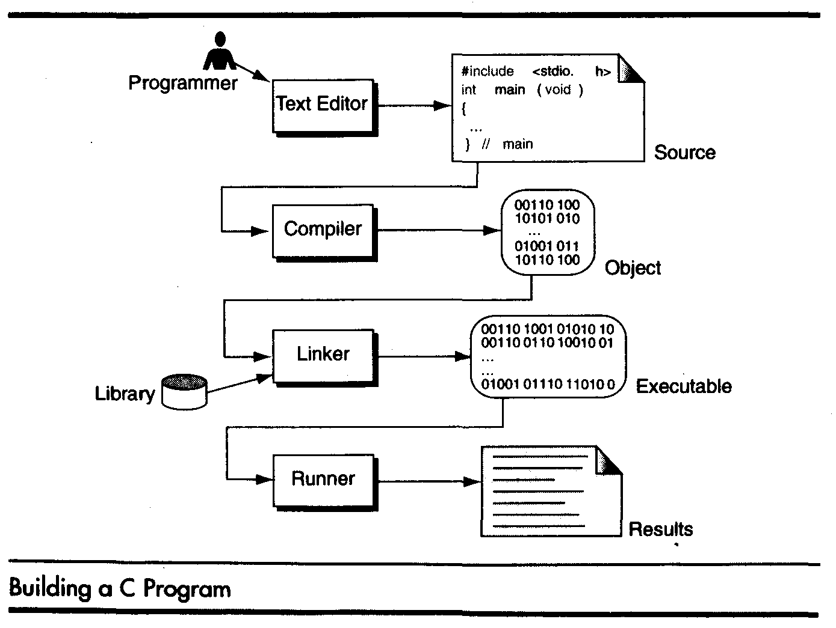
Creating and Running Programs

Slide 56
Creating and Running Programs
Writing and Editing Programs:
The software used to write programs is known as a Text editor (Edit Plus 3).
A text editor allows the user to enter, change, and store alpha numeric character data.
Text editor is a generalized word processor, but it is more often a special editor included with the Compiler.
After completion of writing a program in text editor, we save the program in storage disk with a file name.
This file will be input to the compiler. It is known as a Source File.

Slide 57
Creating and Running Programs
Compiling Programs: The code in a source file stored on the disk must be translated into machine language. This will be done by compiler.
The ‘C’ compiler has two separate programs.
The Preprocessor and the Translator.
The Preprocessor reads the source code and prepares it for the translator. While preparing the code, it scans for special instructions known as Preprocessor commands (or) Preprocessor directives.
After the preprocessor has prepared the code for compilation, the translator (Compiler) converting the program into machine language.
The translator reads the code from translation unit and writes the resulting object module in to a file called Object File. The Object file contains machine language code, but it is not ready to run or execute because it does not have the required ‘C’ and other functions included.

Slide 58
Creating and Running Programs
Linking Programs:
The linker Links/ assembles all of these Library functions, into our final executable program.
  The library functions, such as:
    Standard input/output (stdio.h) functions
    Mathematical library (math.h) functions
    Standard Library functions (stdlib.h) that exist in the system libraries and must be attached to our program.
Executing Programs:
Once program has been linked, it is ready for execution.
To execute a program we use an operating system command, such as RUN, to load the program into primary or main memory and execute it.
Getting the program into primary memory is the function of an operating system program known as the Loader. Once it is loaded, the program takes control and it begins execution.
In a program execution, it reads the input data for processing, either from the user directly at run time or reads from a program file. It Produces output and that can be displayed on the user’s monitor.
Once the program has finished executing, then the operating system takes care of removing the program from main memory.

Slide 59
Software or Program Development Steps
The Software Development Life Cycle (SDLC) is a framework that defines tasks performed at each step in the software development process.
SDLC is a structure followed by a development team within the software organization.
It consists of a detailed plan describing how to develop, maintain, replace and alter specific software.
The life cycle defines a methodology for improving the quality of software and the overall development process.
There are SIX phases in every Software Development Life Cycle (SDLC) Model.
i) Planning - Requirements Gathering.
ii) Analysis – Defining Requirements.
iii) Design.
iv) Implementation
v) Testing & Integration. vi) Deployment & Maintenance.

Slide 60
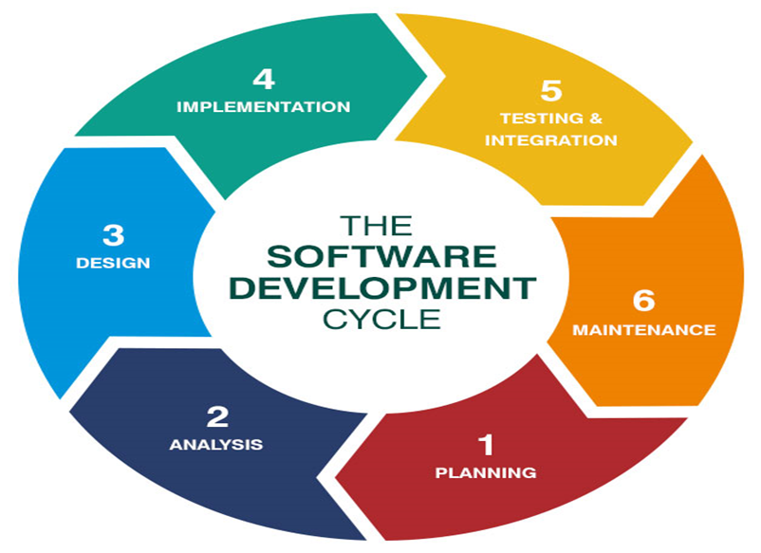
Software or Program Development Steps

Slide 61
Software or Program Development Steps
i) Planning:
  It is the most fundamental part of the SDLC process.
  It is performed primarily by the development team.
  In this phase, the development team gathers the inputs from customers, stakeholders, market research, sales, and others.
  Once everything is clear on the specifications, the team can use the information gained from outside sources to plan the basic project approach and identify potential risks.
  Another aspect of the planning stage is putting together a cost-benefit analysis.
ii) Analysis:
  Analysis requires gathering and interpreting facts, as well as diagnosing issues with the current system and recommending improvements.
  This phase indicates problem-solution step. In this step, the software requirement specification (SRS) document is created that identifies the scope of the project.

Slide 62
Software or Program Development Steps
iii) Design:
  In this phase, the design team uses the SRS to design the product architecture.
  Stakeholders review this document, and a design approach is selected based on their feedback.
  Risk assessment, market research, design modularity, budget, and time constraints must all be taken into consideration.
  Developers and software engineers must be able to develop and deliver the system based on this information with minimal additions.
iv) Implementation:
  This phase is the start of actual development.
  During this phase, it is important for developers to follow the coding guidelines defined by their organization. Developers use various programming tools along with high-level programming languages like C, C++, JAVA and more.
  At the end of this phase, the software is put into production.

Slide 63
Software or Program Development Steps
v) Testing & Integration :
  Testing environment to check for errors, bugs and other issues.
  During the testing phase, the product is checked to ensure that defects are reported, tracked, fixed, and tested again until the product meets quality standards.
vi) Deployment & Maintenance:
  After testing is over, then the product is deployed at customer place and kept under maintenance.
  The ultimate goal of the maintenance phase is to ensure that the product remains relevant and high quality.
  It involves ongoing evaluations of the system’s performance.

Slide 64
Program Design Tools
Program is a set of instructions written to perform particular task.
A program is also called Code.
For developing a Program, we require some strategic plan. The tools needed to Program development are:
a) Pseudo Code:
  Pseudo code is an artificial and informal language that helps programmers to develop Algorithms.
  Pseudo code is similar to everyday English.
  Pseudo code programs are not actually executed on computer.
  Pseudo code is like an English statement that follows a defined syntax and that are used to convey the design of an algorithm.

Slide 65
Introduction to Algorithms
Algorithm: Algorithm is a step-by-step logical procedure to solve a given problem.
Algorithm was developed by an Arab mathematician.
Before solving a given problem, we need to find the solution of the problem in a systematic, disciplined, non-adhoc, Step-by-step way is called Algorithmic approach.
The algorithm must have/ Satisfy the following Properties.
  Finiteness: an algorithm must terminate in a finite number of steps.
  Definiteness: each step of the algorithm must be defined clearly.
  Effectiveness: each step of the algorithm must be effective. Means easy conversable to program syntax.

Slide 66
Introduction to Algorithms
Find sum of first 10 natural numbers and print the result.
Step 1: Start the program.
Step 2: Declare the variables with data types.
Step 3: Initialize the input values n=1 and Sum=0.
Step 4: check the condition If (n<=10).
begin
sum = sum + n;
n = n+1;
end.
Step 5: Print the sum value.
Step 6: Stop the process.

Slide 67
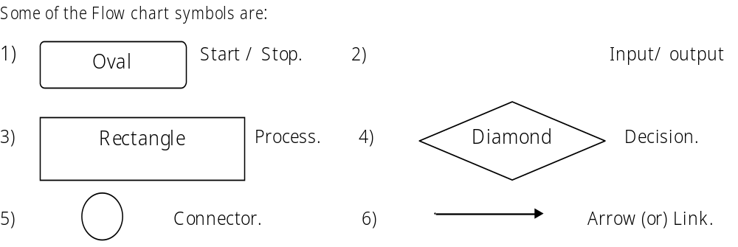

FLOW CHART
Flow chart is a diagrammatic (or) Pictorial representation of an Algorithm.
  The flow chart can be constructed by using different symbols like Rectangle, Diamond, Oval and small circles.
  These symbols are connected by arrows called flow lines.
  The operation of the step can be written inside of the Symbol.

Slide 68
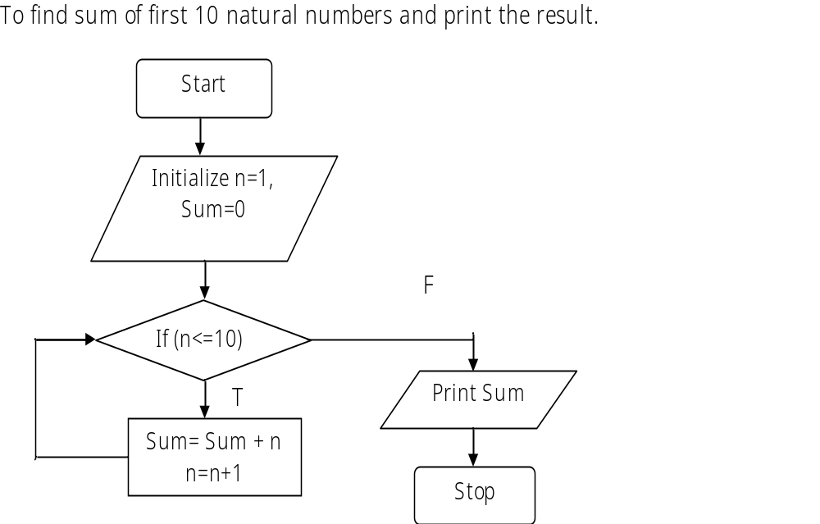
FLOW CHART

Slide 69
Number Systems
Bit: Bit is a smallest unit of data
1 bit = 0 (or) 1.
Byte: It is a sequence of 8 bits processed as a single unit of information.
1 byte = Group of 8–bits.
1 nibble = Group of 4–bits.
1 KB (Kilo byte) = 1024 bytes.
1 MB (Mega byte) = 1024 KB = (1024)² Bytes
1 GB (Giga byte) = (1024)³ Bytes.
1 TB (Tera byte) = (1024)⁴ Bytes.
1 PB (Peta byte) = (1024)⁵ Bytes.

Slide 70
Character Codes
The computer can understand Binary language only.
It converts any data (i.e., Integer, Real, Character) in the form of binary code.
For converting character data in to binary, it uses Character codes.
There are three types of character codes.
(i) ASCII (ii) EBCDIC (iii) UNI-code.
i) ASCII: American Standard Code for Information Interchange.
  It is a 7-bit code representation.
  By using this 7-bit code we can represent 2⁷ = 128 (i.e., 0-127) different characters.
  It includes 26 upper case letters (A-Z), 26 lower case letters (a-z), 10 numbers (0-9), 33 special characters and 33 special symbols. A–Z (65-90) a–z (97-122) 0 – 9 (48-57)

Slide 71
Character Codes
EBCDIC: Extended Binary Coded Decimal Interchange.
  It is an 8-bit code representation.
  By using this 8-bit code we can represent 2⁸ =256 (0-255) different characters.
  The EBCDIC code was developed by IBM Corporation.
  It is used in Mainframe computers and super computers.
  The EBCDIC 8-bit code is also divided in to two portions. The left most 4-bits is called zone bits and remaining 4-bits is called numeric bits.
UNI-code: Universal code.
  It is a 16-bit code representation.
  By using this 16-bit code we can represent 2¹⁶ = 65536 (0 - 65535) different characters.
  Developed jointly by Apple Corporation and Xerox Corporation in the year 1991.
  The major goal of Unicode is, to represent each and every character in the world. The language JAVA uses Unicode.

